Slide 1
Single-Valley BASIS
Picking a basis to describe the donor electron state of a particular valley.

Slide 2
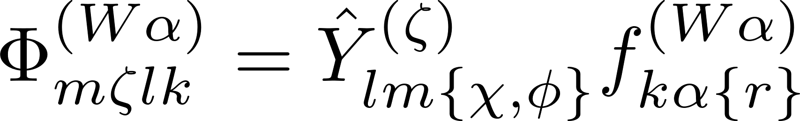
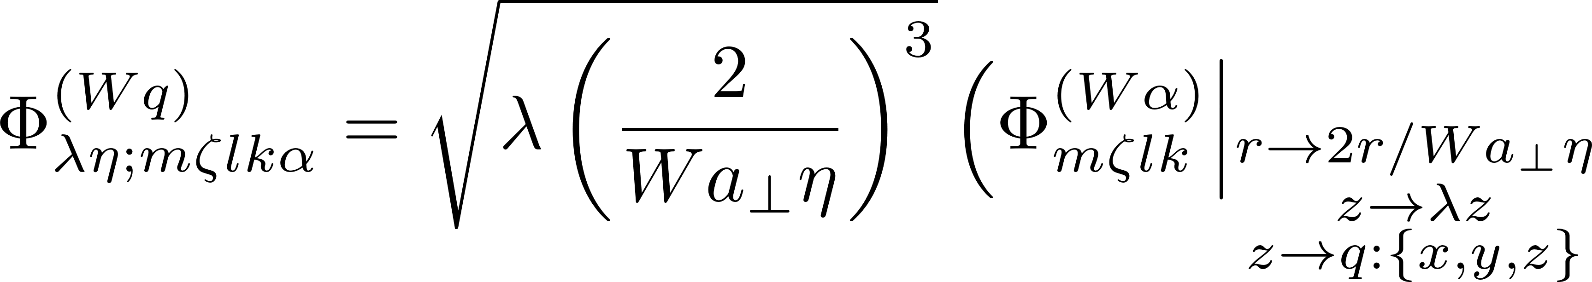
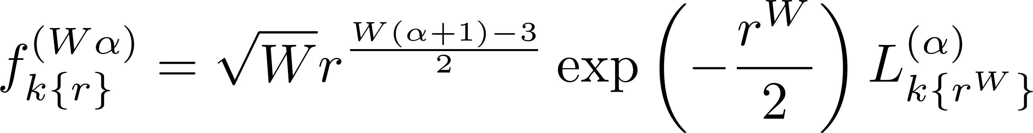
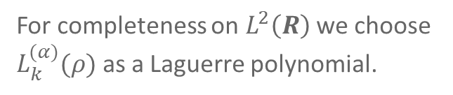
The naïve basis functions defined
α is a parameter to guarantee orthonormality and integrability.
For completeness on $L^{2}\left(R\right)$ we choose $L_{k}^{(α)}(ρ)$ as a Laguerre polynomial.

Slide 3
Kinetic OperATOR
Defining the effective kinetic matrix elements

Slide 4
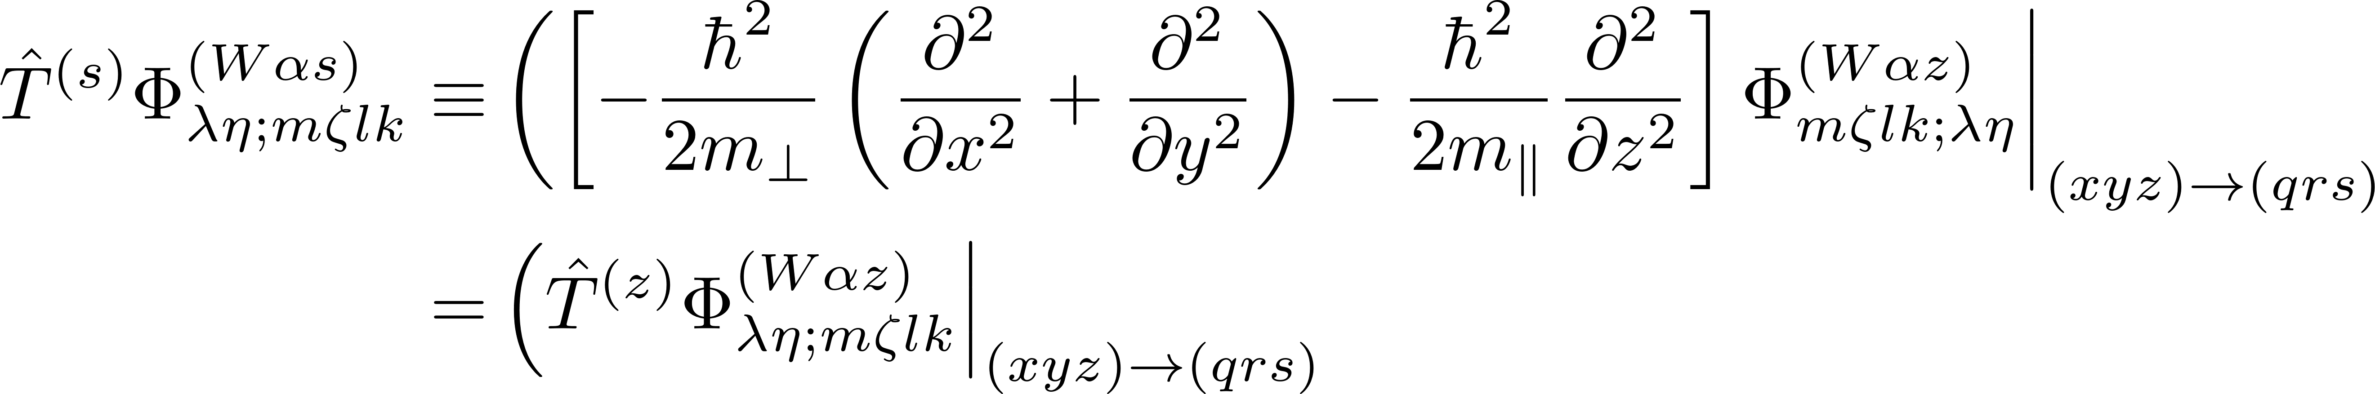
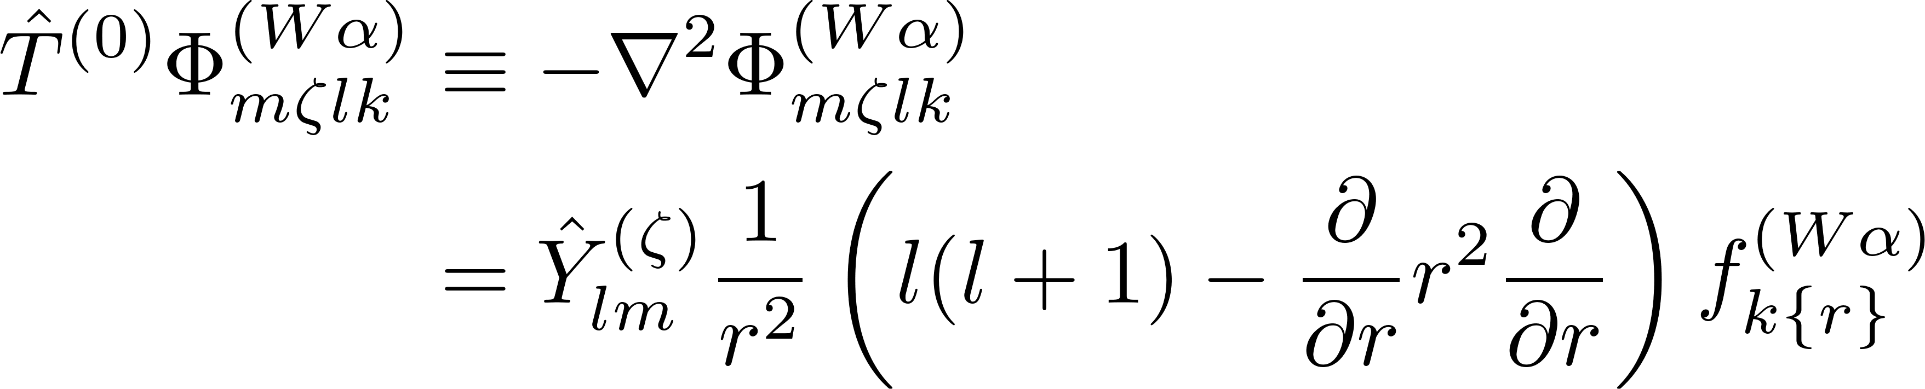
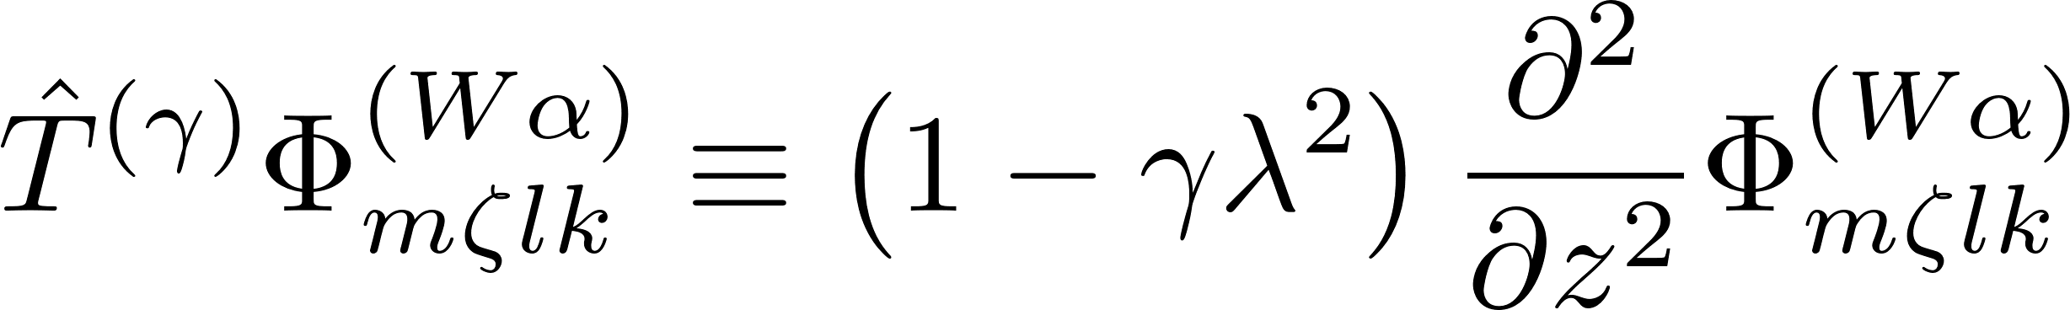
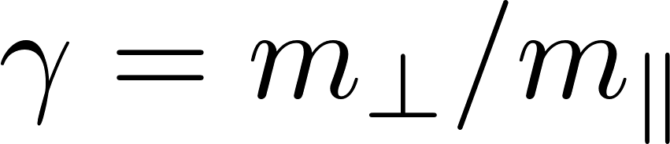
Operators used for kinetic matrix elements defined

Slide 5
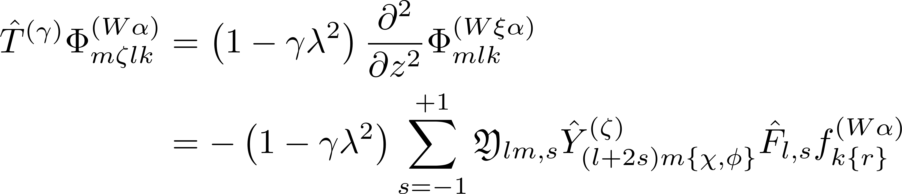
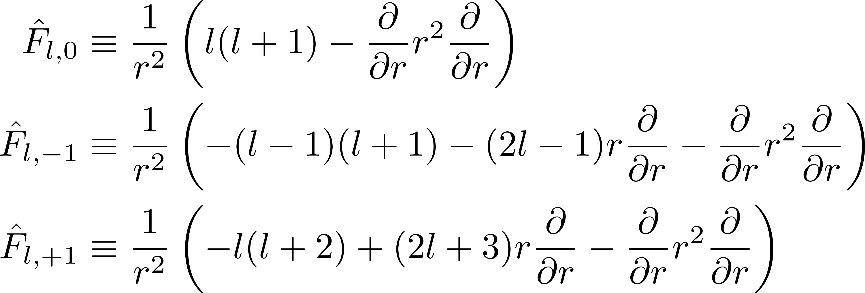
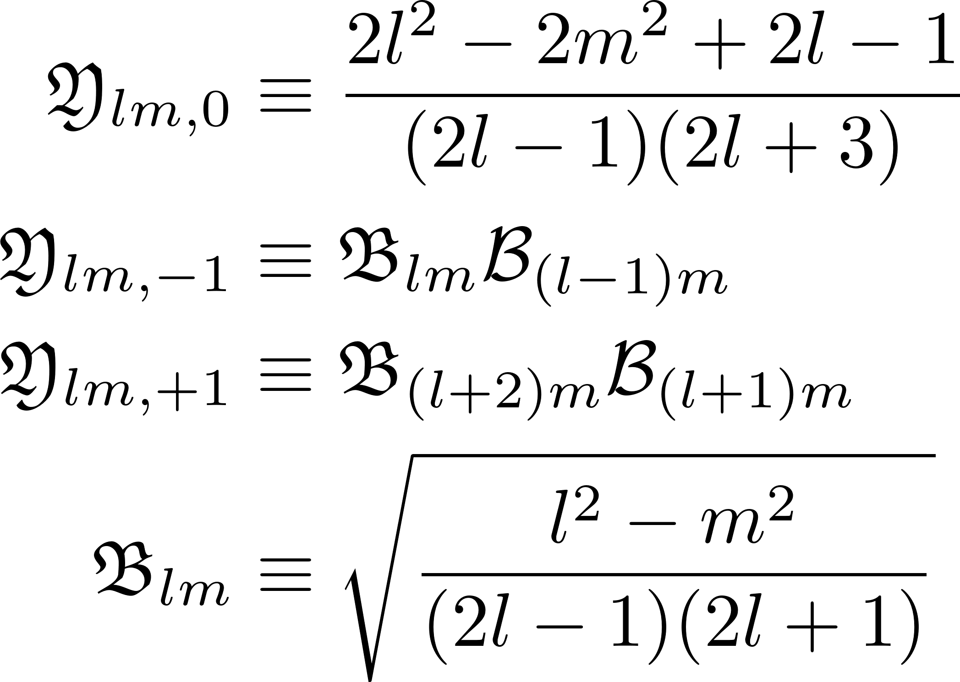
Elaborating the anisotropic kinetic operator

Slide 6
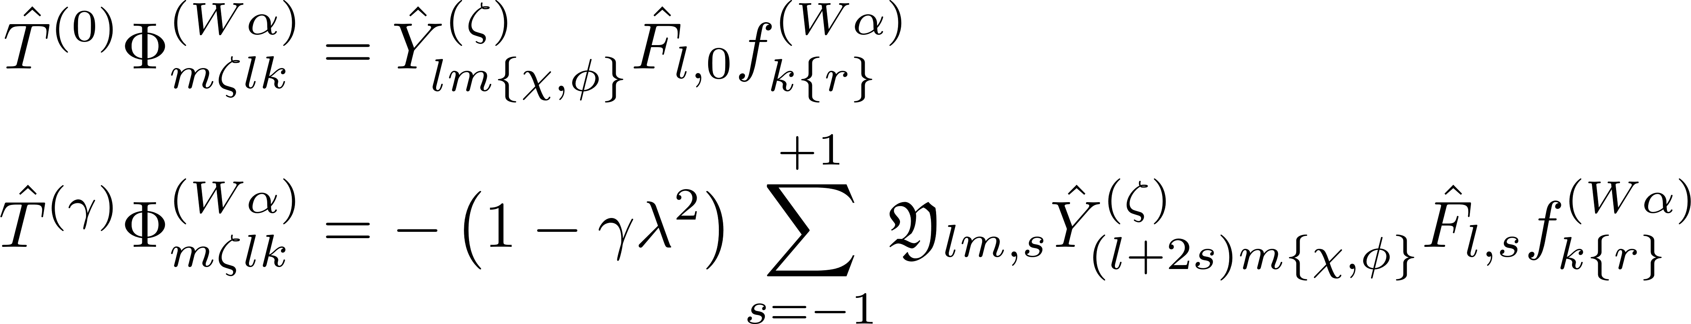
Restating effects of the iso- and anisotropic kinetic operators

Slide 7
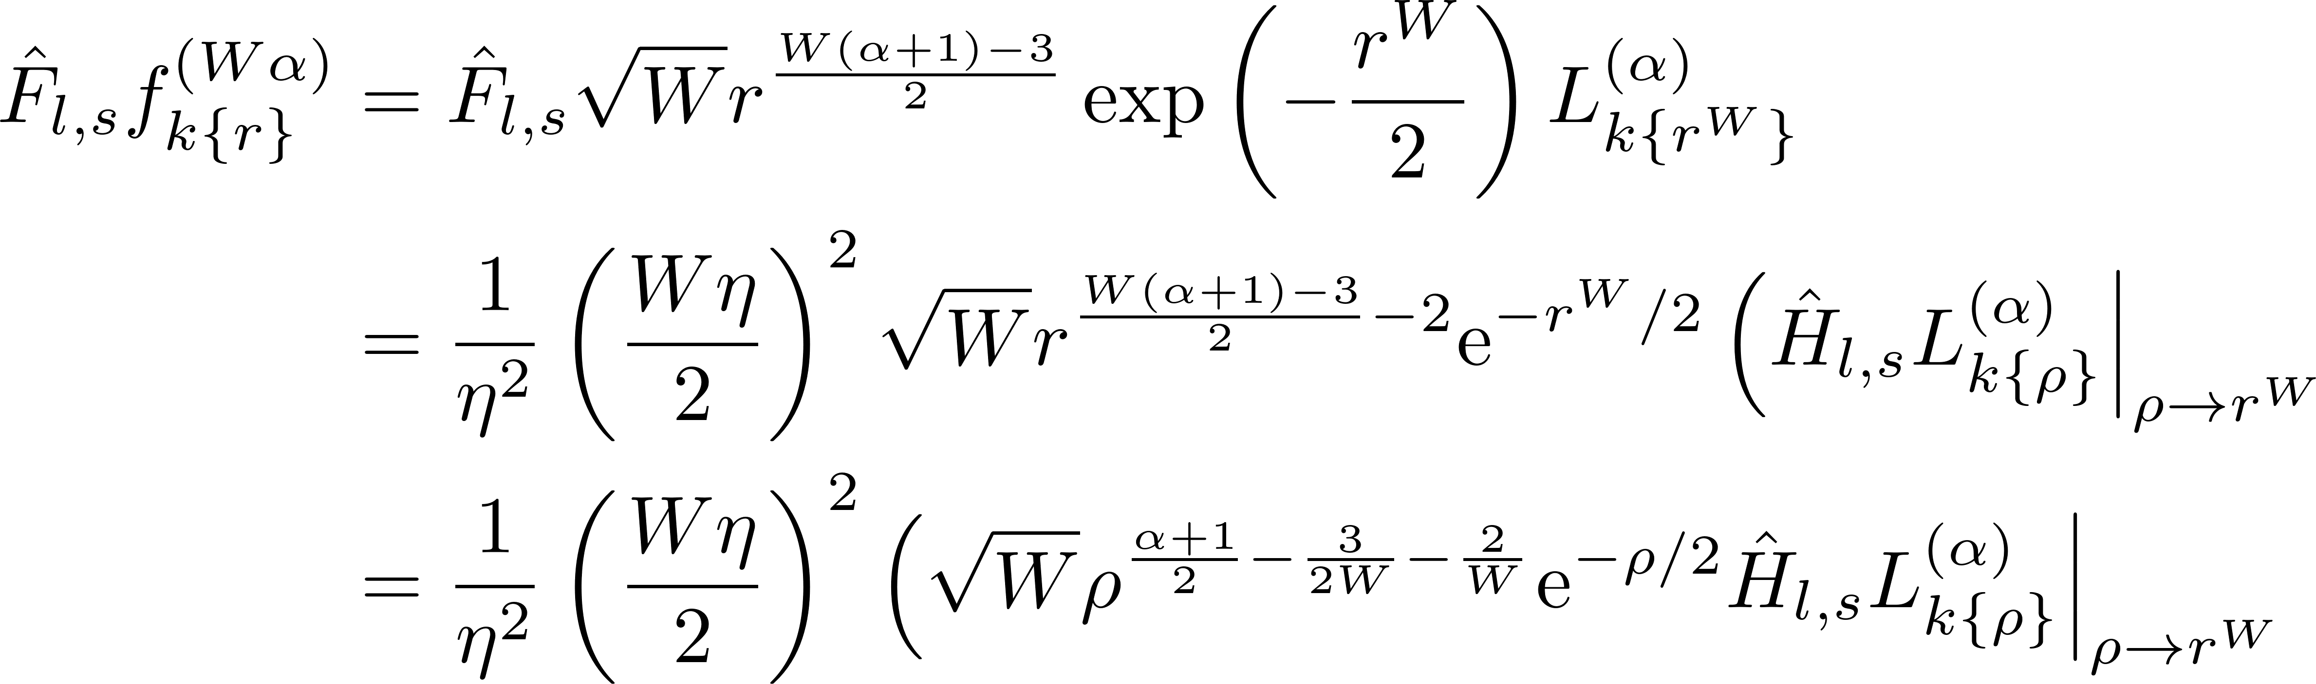
Further examination of the effect of the kinetic operators

Slide 8
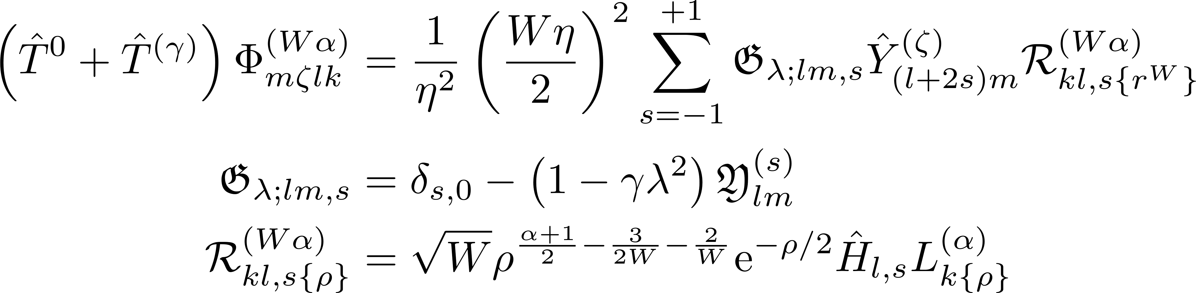
Combined effect of kinetic operators

Slide 9
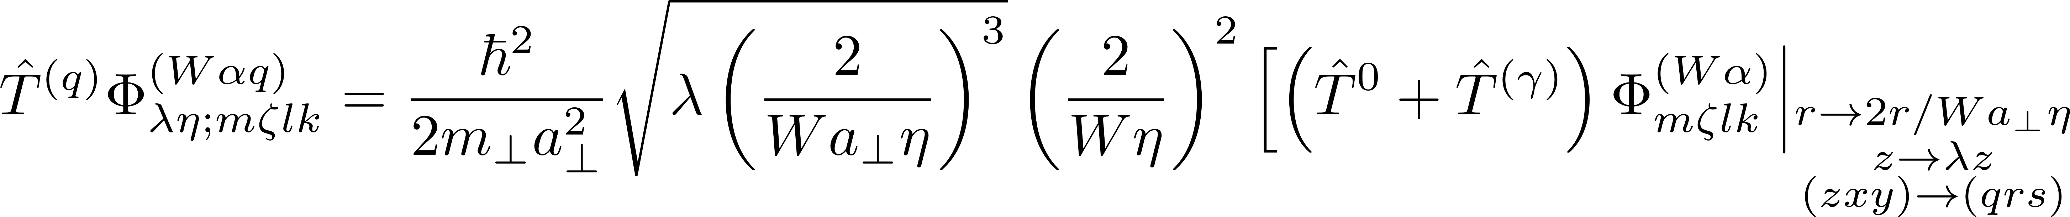
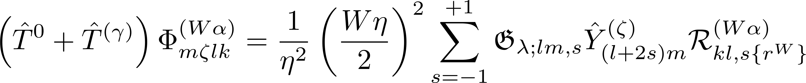
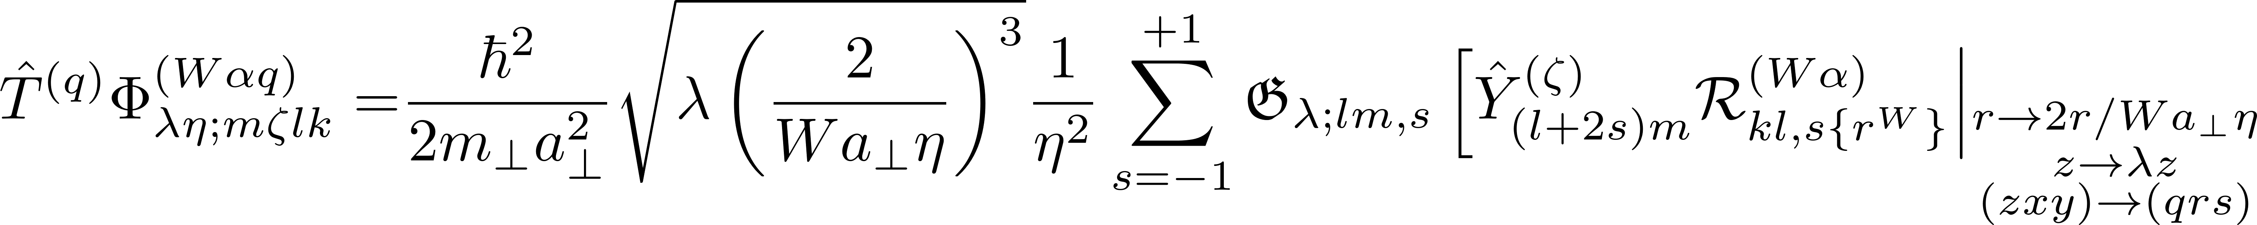
Restatement of effect of full kinetic operator

Slide 10
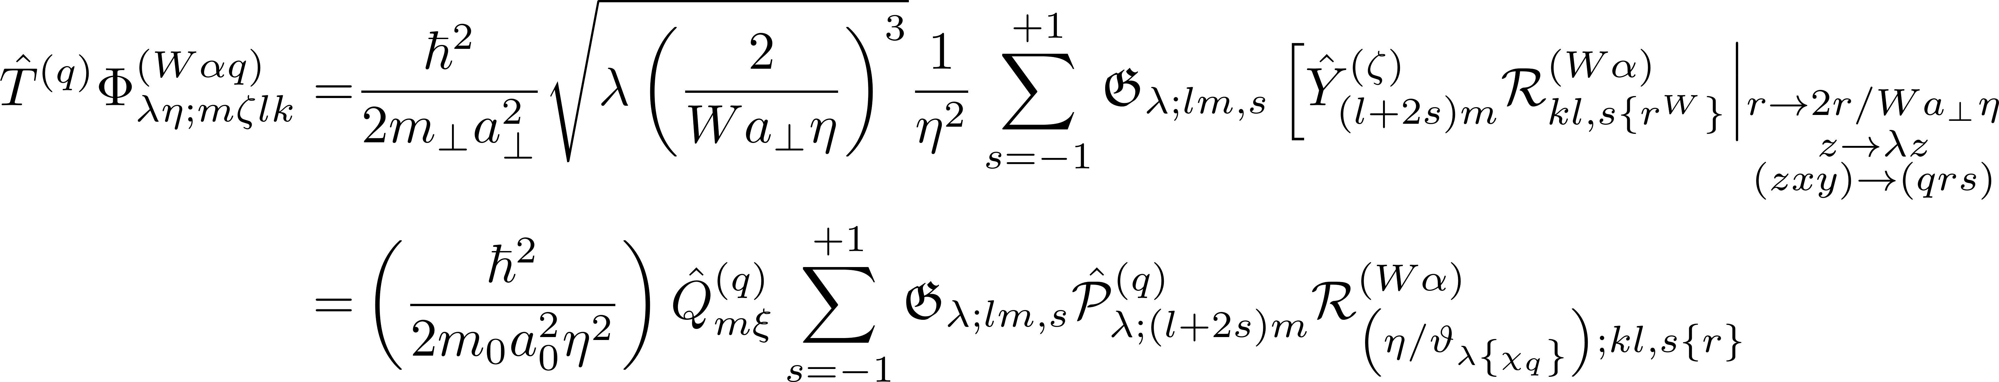
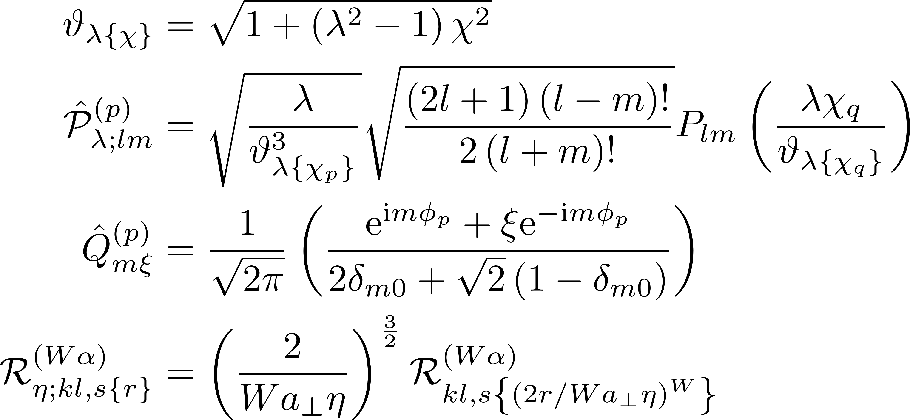
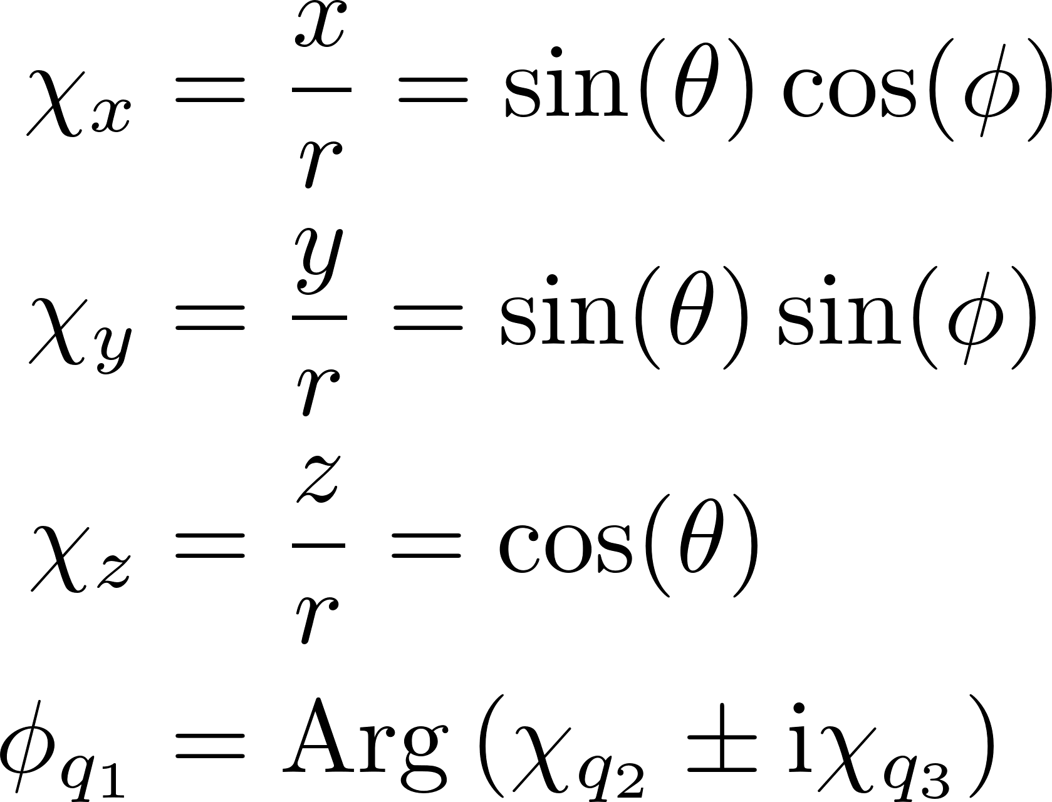
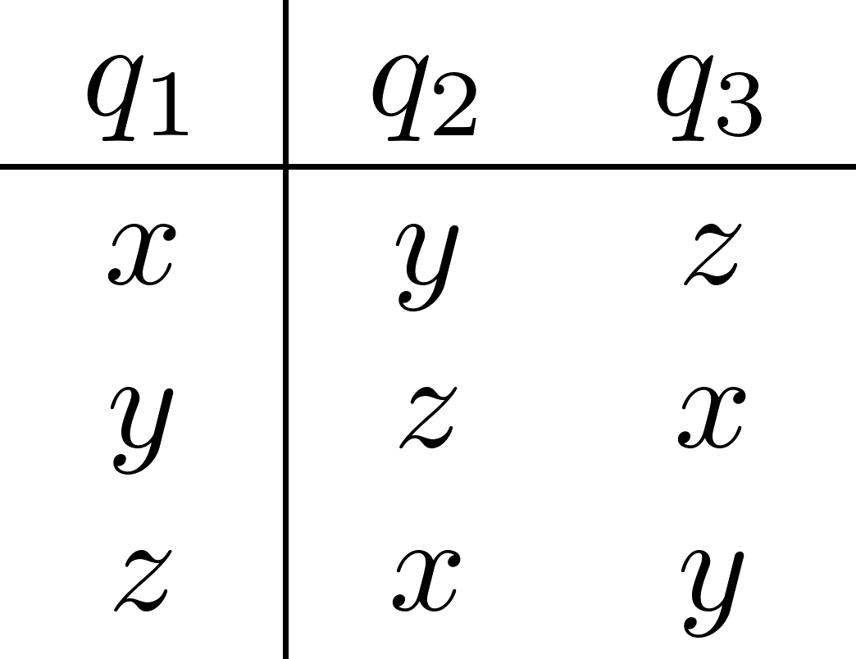
Restatement of effect of full kinetic operator

Slide 11
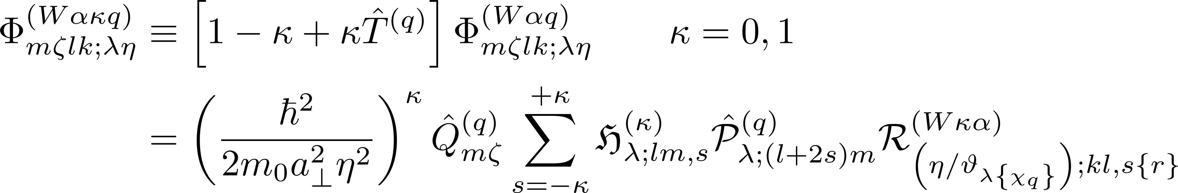
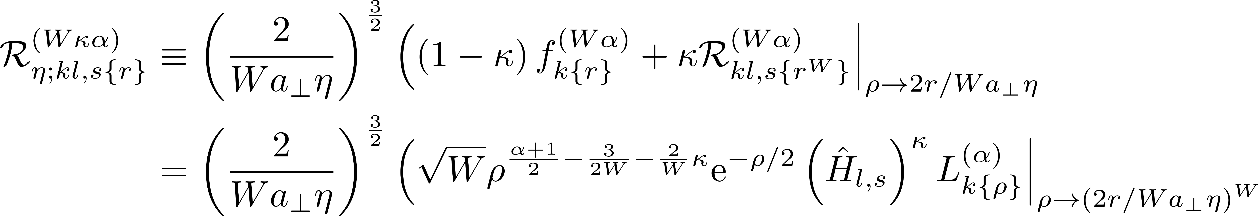
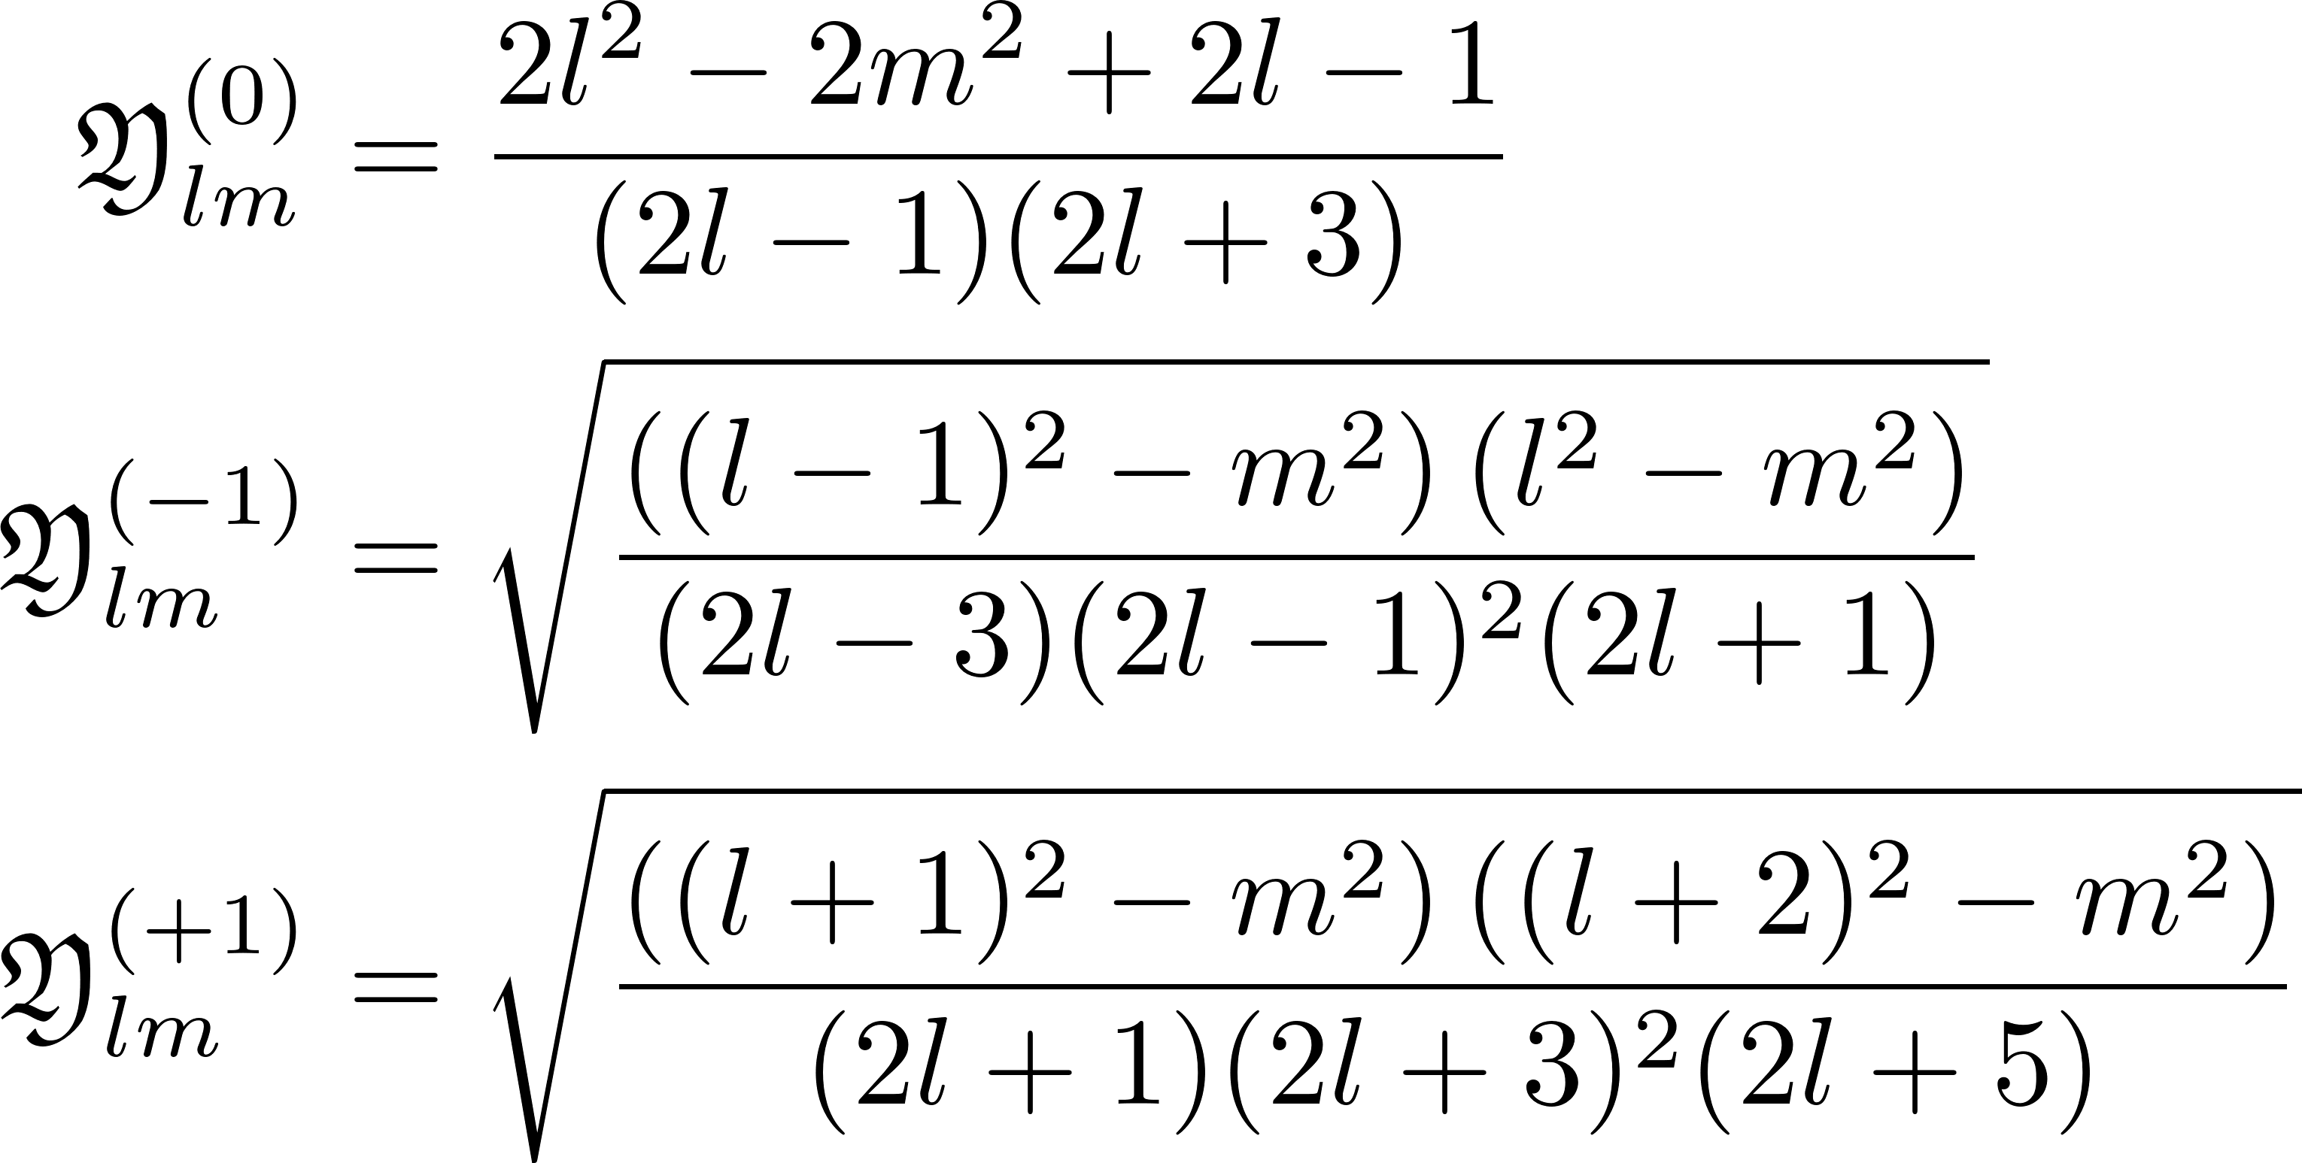
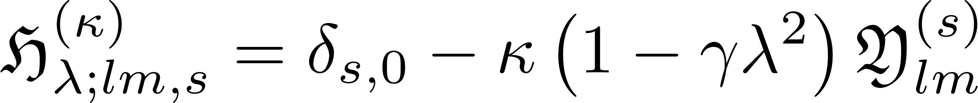
Definition of the generalized single-valley basis states

Slide 12
Operator Effects
Finding formulae for the new polynomials

Slide 13
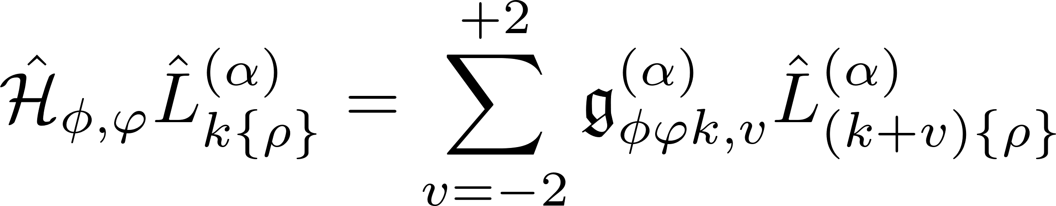
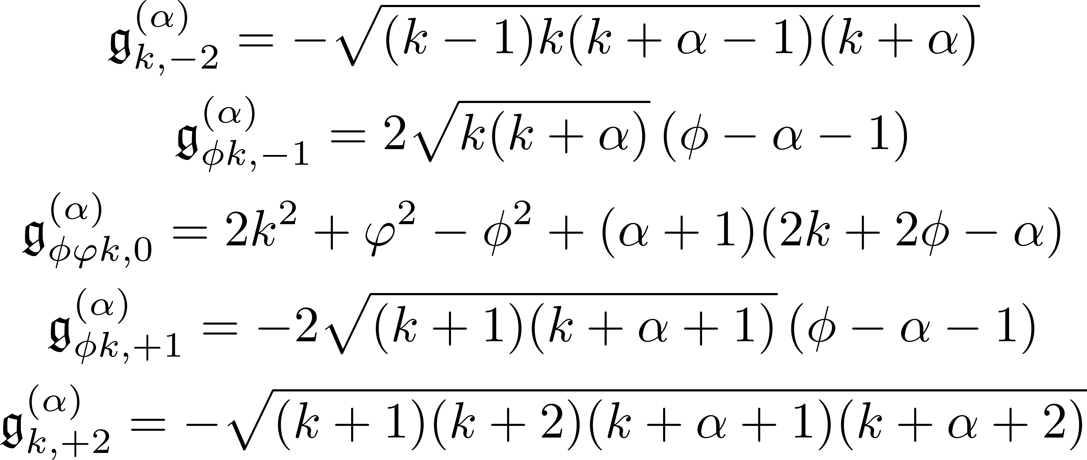
Generic kinetic operator acting on Laguerre polynomials

Slide 14
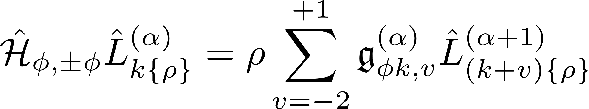
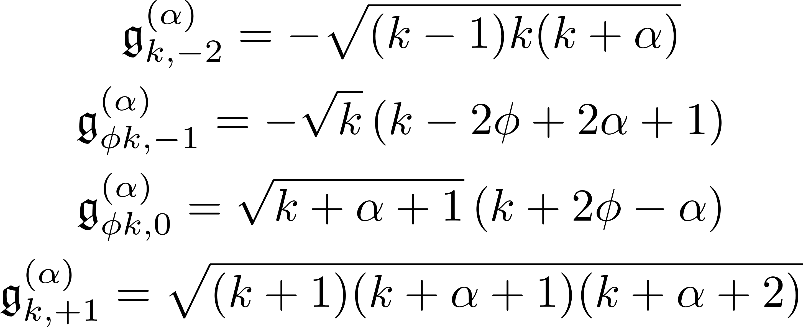
Generic kinetic operator acting on Laguerre poly. ($φ^{2}=φ^{2}$)

Slide 15
Expectation Values
Understanding integrability

Slide 16
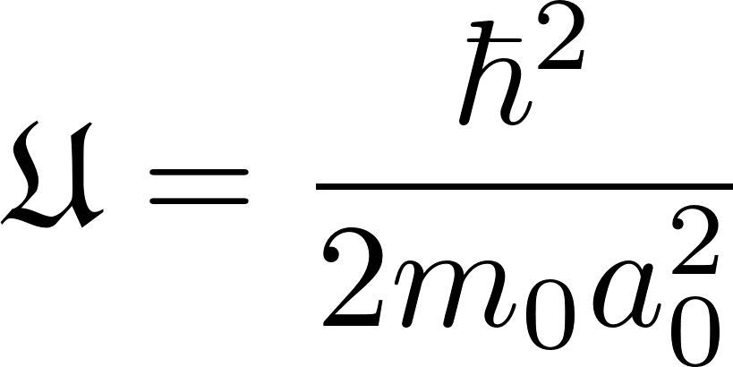
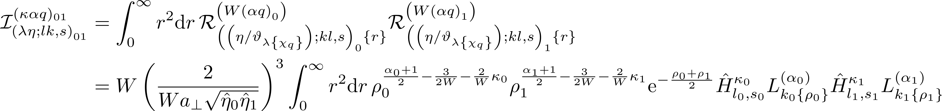
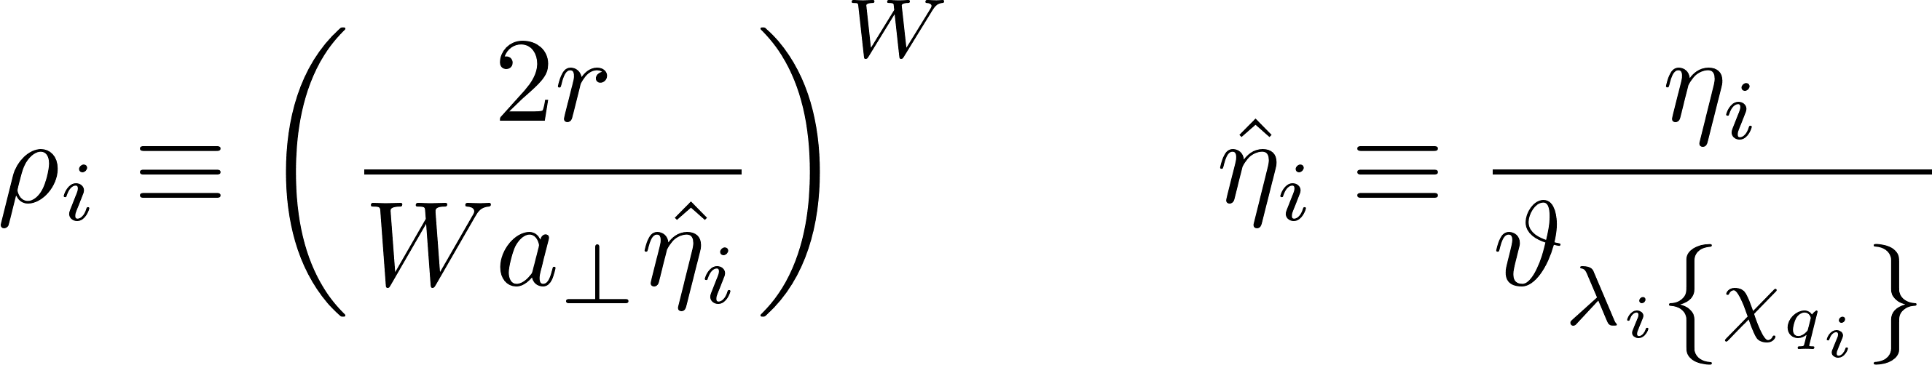
Examining the expectation values (Overlap, Kinetic, KinKin)

Slide 17
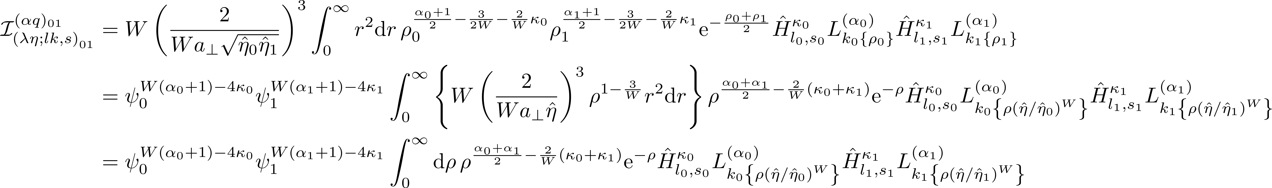
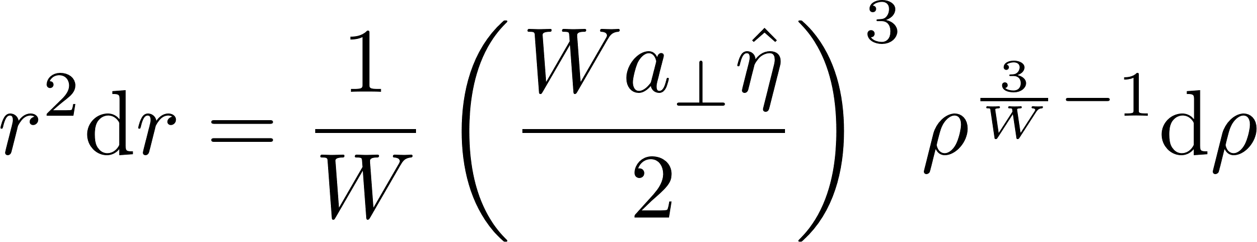
Examining the expectation values

Slide 18
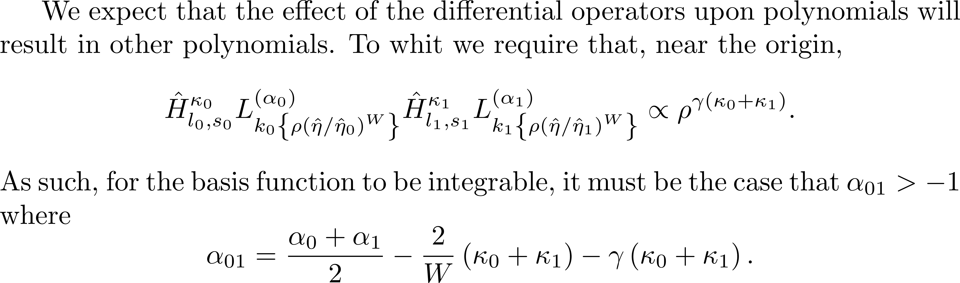
2. Integrability condition

Slide 19
Determining Alpha
Understanding integrability

Slide 20
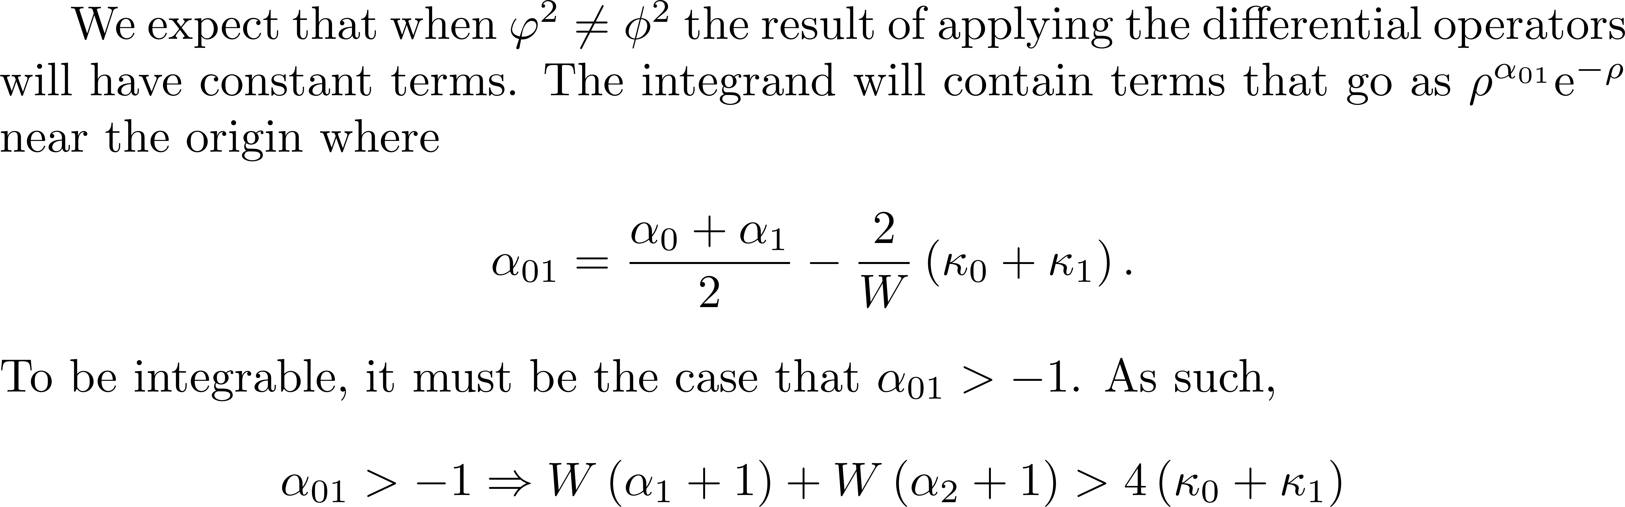
1. Exploring regimes of applicability for $φ^{2}≠φ^{2}$

Slide 21
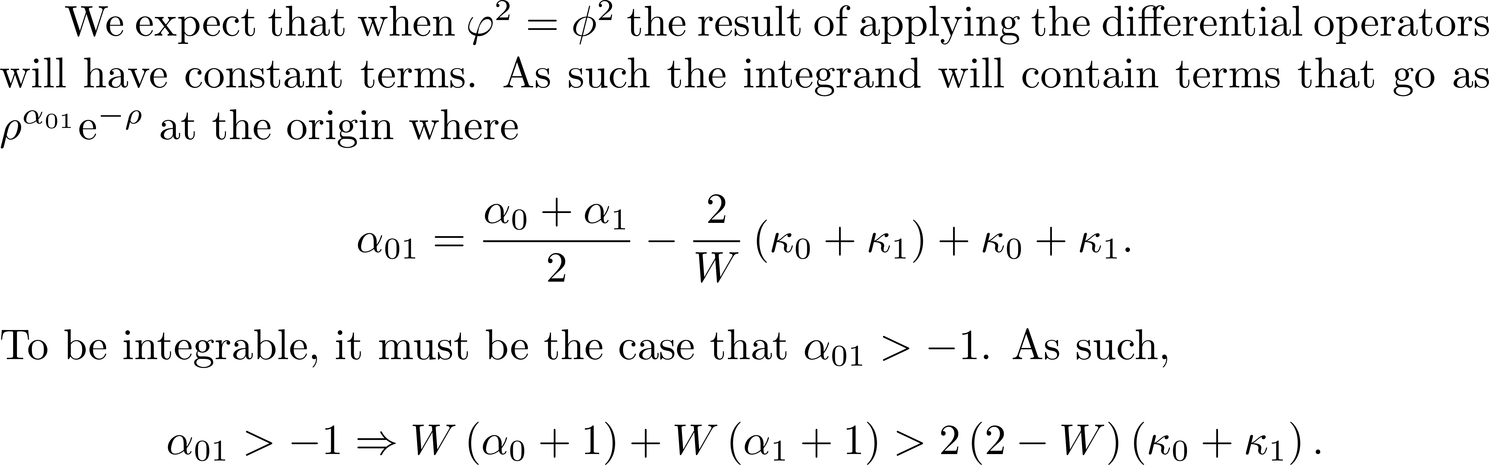
2. Exploring regimes of applicability for $φ^{2}=φ^{2}$

Slide 22
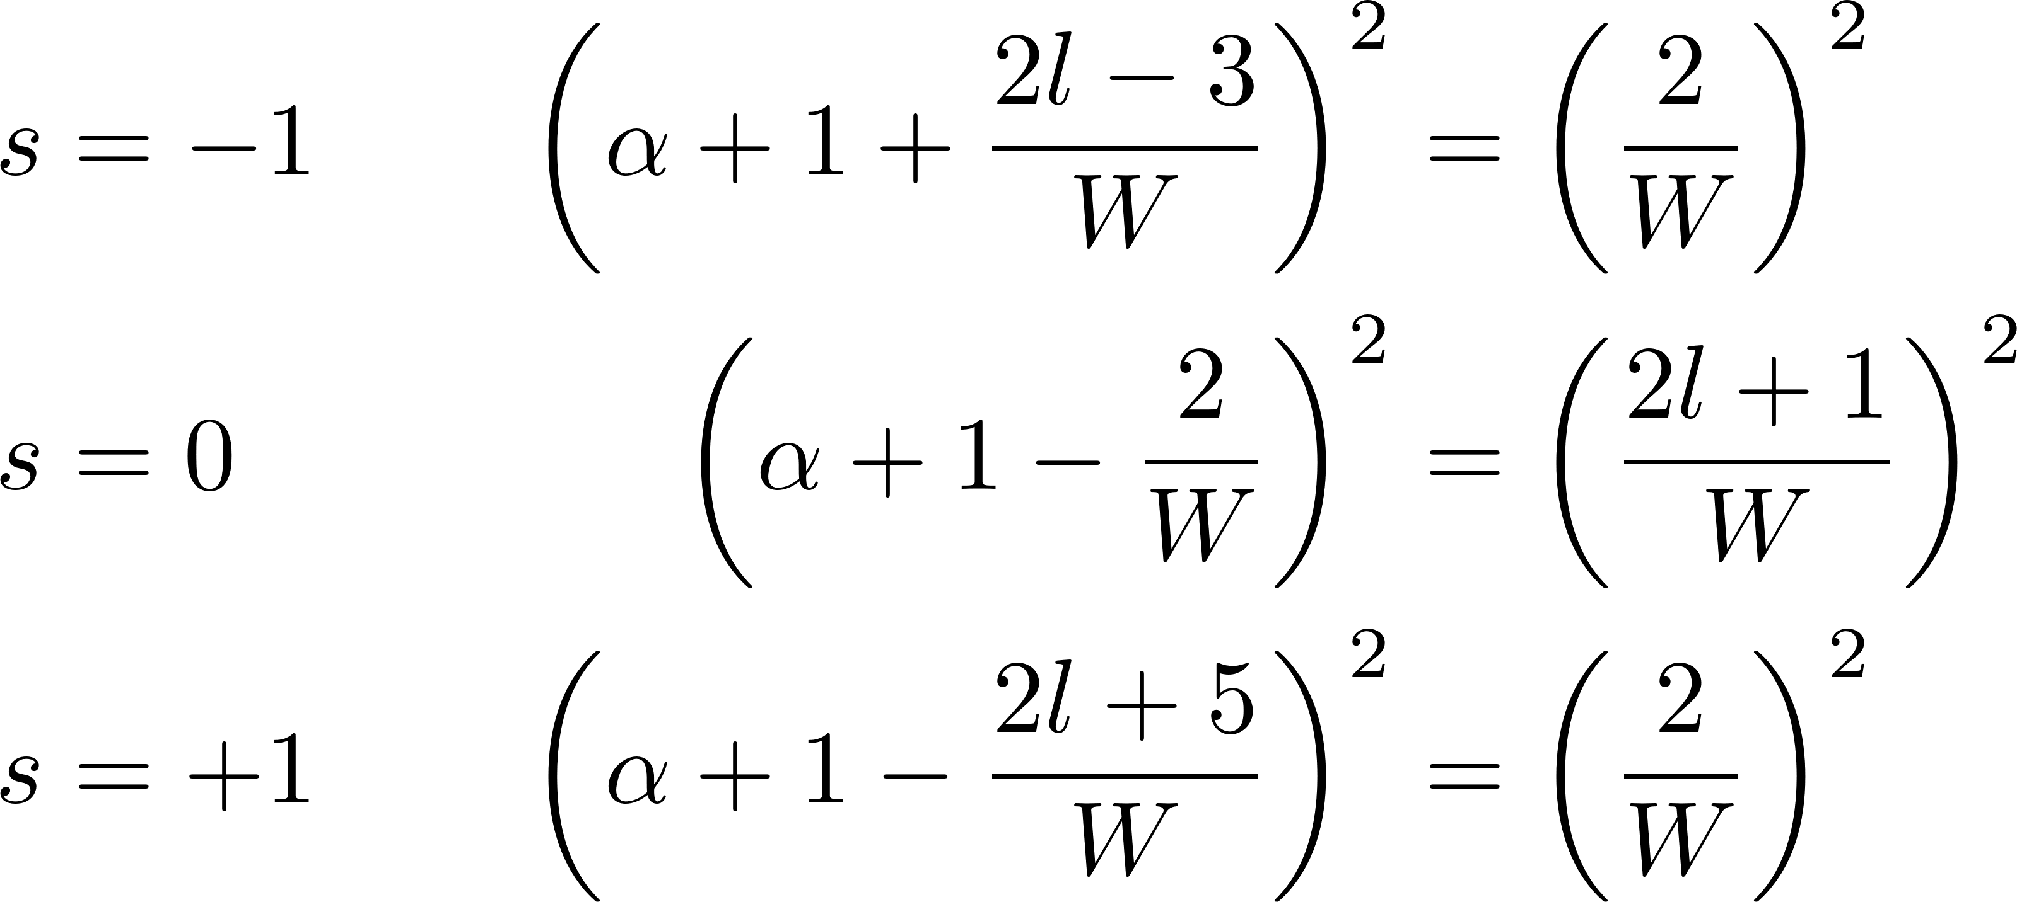
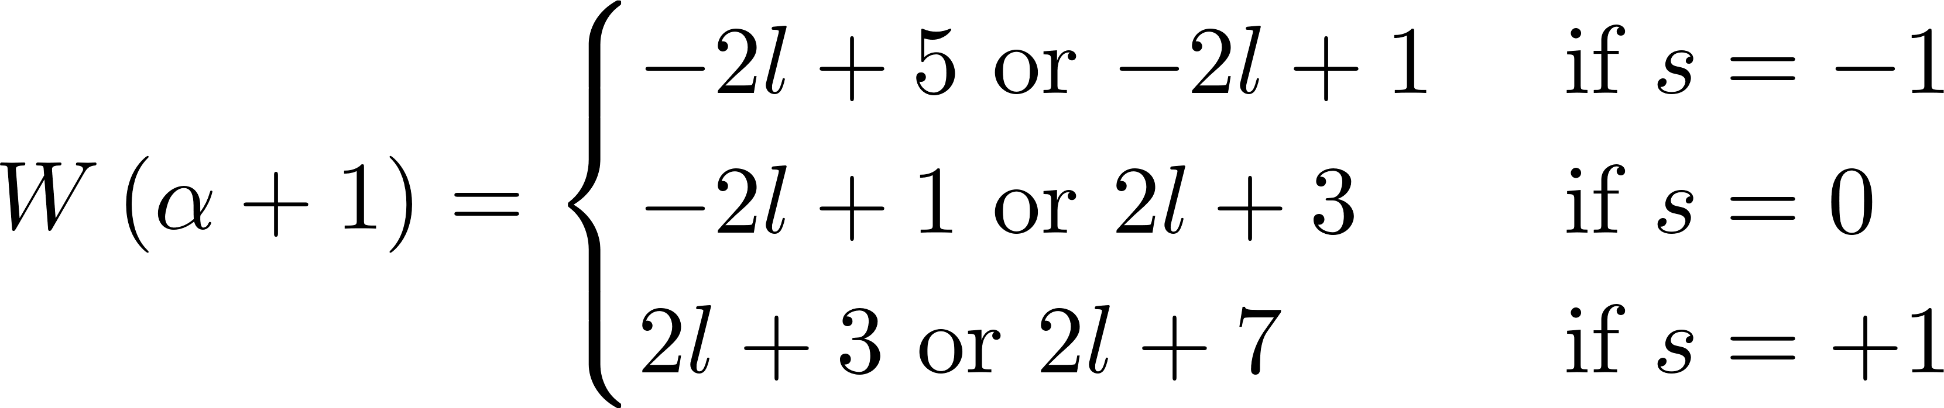
3. What criteria on α is required to achieve $φ^{2}=φ^{2}$?
* Not possible to accomplish $φ^{2}=φ^{2}$ for a given α(l) and all values of s.

Slide 23
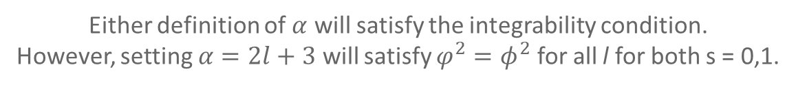
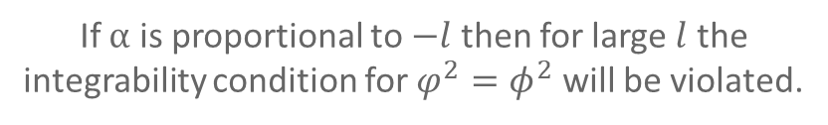
4. Exploring regimes of applicability for $φ^{2}=φ^{2}$
If $α$ is proportional to $−l$ then for large $l$ the integrability condition for $φ^{2}=φ^{2}$ will be violated.
Either definition of $α$ will satisfy the integrability condition.
However, setting $α=2l+3$ will satisfy $φ^{2}=φ^{2}$ for all l for both s = 0,1.

Slide 24
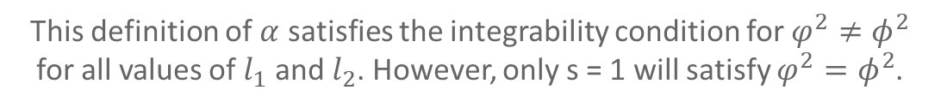
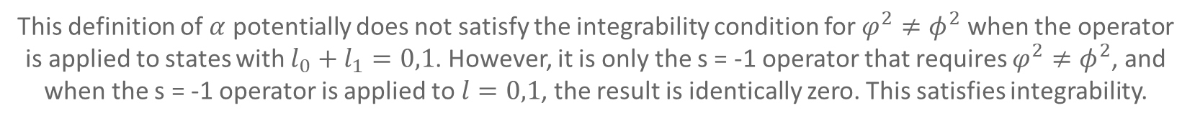
5. Exploring regimes of applicability for $φ^{2}≠φ^{2}$.
This definition of $α$ potentially does not satisfy the integrability condition for $φ^{2}≠φ^{2}$ when the operator is applied to states with $l_{0}+l_{1}=0,1$. However, it is only the s = -1 operator that requires $φ^{2}≠φ^{2}$, and when the s = -1 operator is applied to $l=0,1$, the result is identically zero. This satisfies integrability.
This definition of $α$ satisfies the integrability condition for $φ^{2}≠φ^{2}$ for all values of $l_{1}$ and $l_{2}$. However, only s = 1 will satisfy $φ^{2}=φ^{2}$.

Slide 25
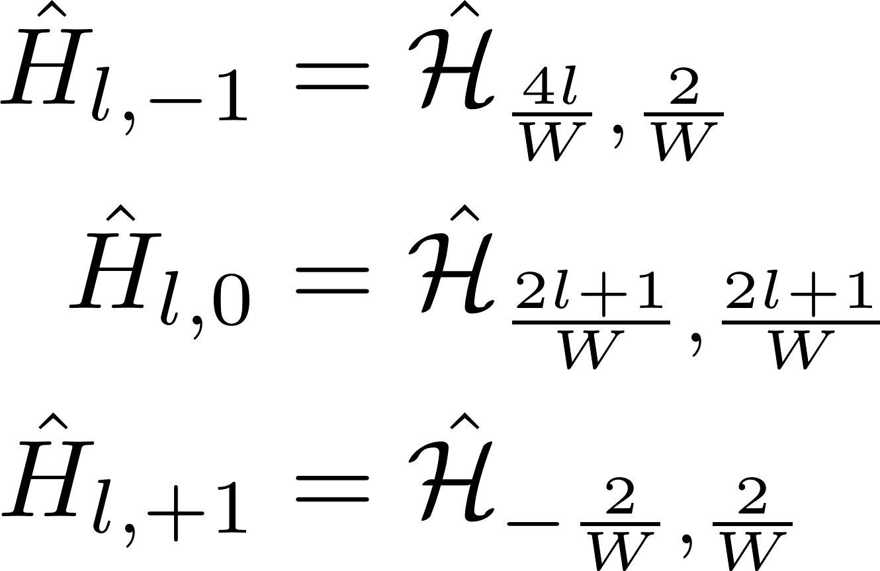
6. Making the best choice of $α$
So it makes more sense to use $W\left(α+1\right)=2l+3$. This satisfies all conditions for integrability over all state indices, and reduces the number of terms introduced by the kinetic differentiation.

Slide 26
Finishing Up
Understanding the effect of the suboperators

Slide 27
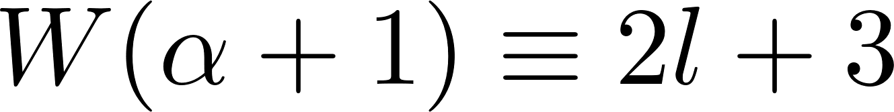
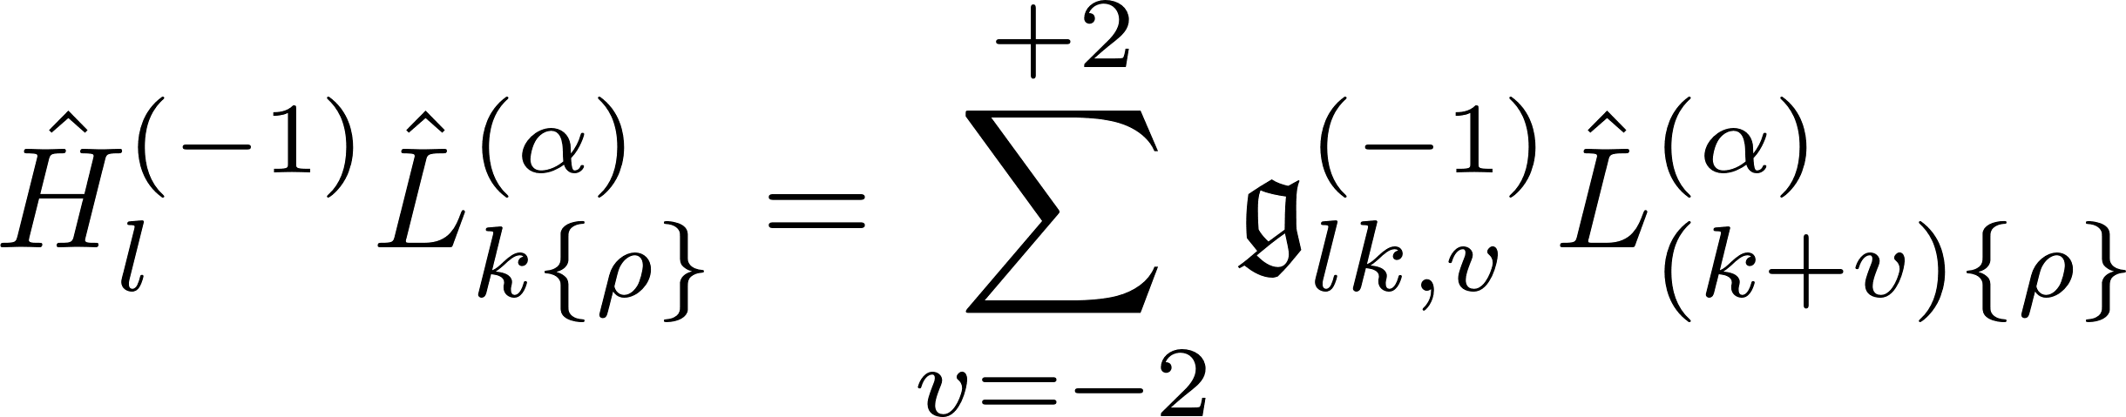
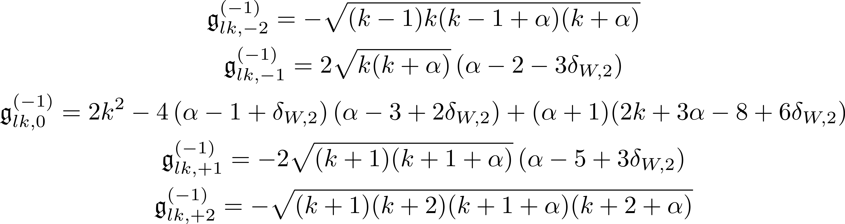
Effect of final kinetic suboperator – $s=−1$

Slide 28
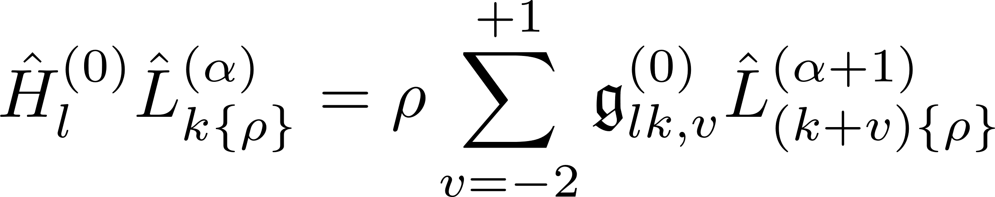
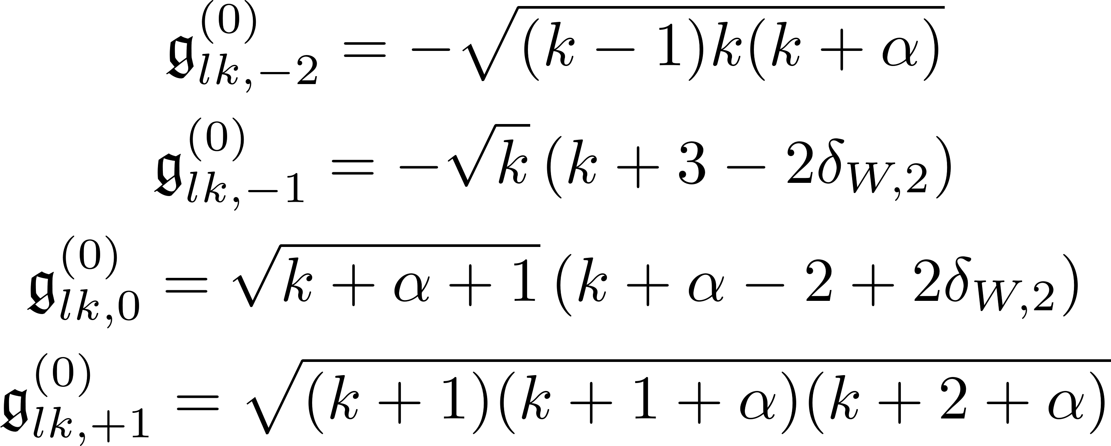
Effect of final kinetic suboperator – $s=0$

Slide 29
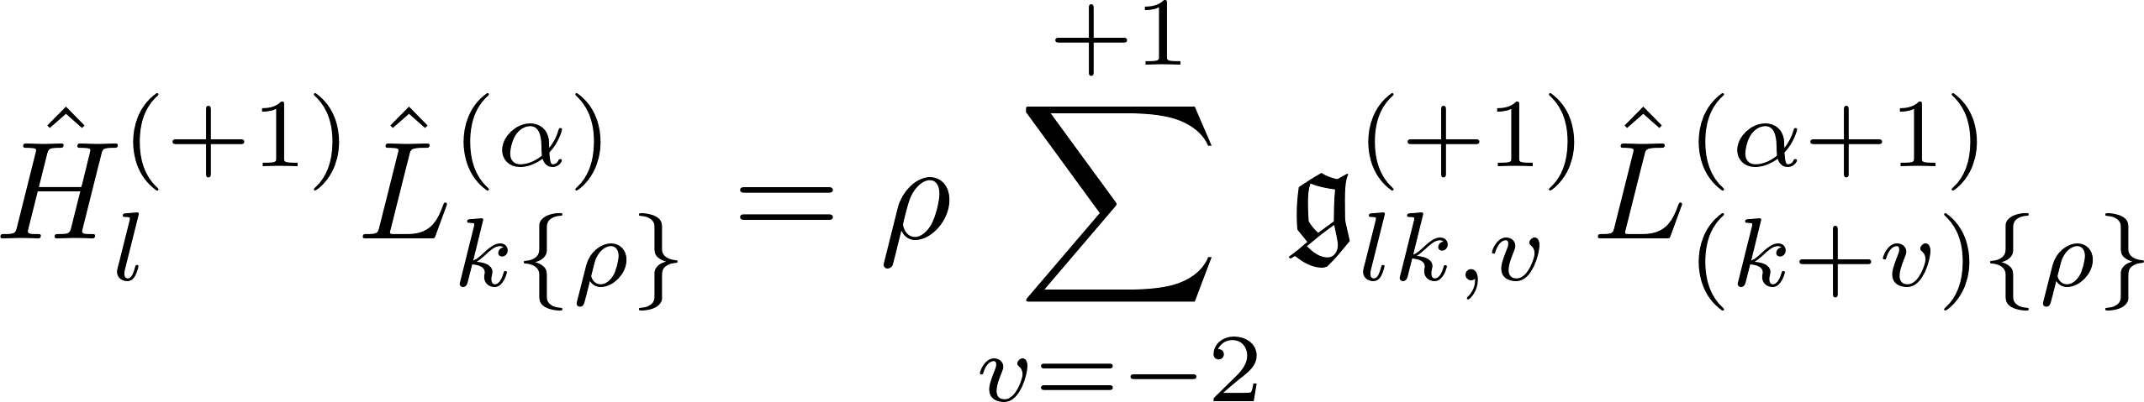

Effect of final kinetic suboperator – $s=+1$

Slide 30
GENERALIZED BASIS STATES
The basis state, both original and with the kinetic operator applied, expressed in one formula.

Slide 31


Generalized basis states -- I

Slide 32


Generalized basis states -- II

Slide 33
APPENDIX

Slide 34

Relations involving the Laguerre polynomial -- I

Slide 35

Relations involving the Laguerre polynomial -- II

